Slide 1


Synopsis Presentation on Predictive Modelling Using Historical Sales Data To Forecast Future Product Demands
Guided By: Presented By:
Prof. Mahendra Verma Khushi Agrawal
Atharv Sharma
Akshat Soni
Amay Saxena

Slide 2
Contents
Introduction
1.1 Overview
1.2 Purpose
Literature Review
Problem Statement
Proposed Solution
Objectives
Theoretical Analysis
6.1 Block Diagram
6.2 Hardware Requirements
6.3 Software Requirements
Applications
8. References

Slide 3
1. Introduction
1.1 Overview
In the fast-paced and competitive business environment, effective inventory management is essential for operational success. Businesses often face challenges in accurately forecasting product demand, which can lead to stockouts (resulting in lost sales and customer dissatisfaction) and overstocking (leading to increased holding costs and waste).
This project aims to develop a Smart Inventory Management system that leverages historical sales data to enhance demand forecasting accuracy.
By analyzing past sales trends and patterns, the system will provide businesses with the tools to optimize inventory levels, ensuring that products are available when needed while minimizing excess stock.
1.2 Purpose
Improved Demand Forecasting: Utilizes historical sales data to predict future product demands accurately.
Minimizes Stockouts: Reduces the risk of stockouts by aligning inventory levels with anticipated demand.
Reduces Overstocking: Prevents overstocking by optimizing inventory levels based on data-driven insights
Enhances Operational Efficiency: Streamlines inventory management processes, allowing businesses to make informed decisions and improve overall efficiency.

Slide 4
2. Literature Review
Summary of Solutions/Systems already available that are addressing the same issue/problem.
Sr. No. | Name of Solution/System | Features | Limitations/ Drawbacks
1. | Traditional Inventory Management | Manual record-keeping and stock monitoring. | High risk of human error and inefficiency.
2. | ERP-Based Inventory Systems | Automated stock tracking, demand analysis, and order management. | High implementation and maintenance costs.
3. | AI-Powered Inventory Forecasting | Uses machine learning to predict future demands and optimize stock levels. | Requires large amounts of historical data for accuracy.

Slide 5
3. Problem Statement
Many businesses struggle with inefficient inventory management practices, leading to stockouts, overstocking, and increased operational costs. The key issues include:
Inaccurate demand forecasting due to a lack of analysis of historical sales data.
Difficulty in maintaining optimal inventory levels, resulting in lost sales or excess stock.
Existing systems often lack real-time insights and analytics, making it challenging for businesses to respond to changing market demands.

Slide 6
4. Proposed Solution
The proposed solution is to develop a Smart Inventory Management system that incorporates the following features:
Historical Sales Data Analysis: Analyze past sales data to identify trends and patterns that inform future demand forecasts.
Automated Forecasting Models: Implement forecasting models (e.g., time series analysis, machine learning) to predict future product demands.
Real-Time Inventory Tracking: Monitor stock levels in real-time to prevent stockouts and overstocking.
User -Friendly Interface: Design an intuitive interface that allows users to easily navigate and manage their inventory.

Slide 7
5. Objectives
Enhance Forecast Accuracy: Improve the accuracy of demand forecasts by utilizing historical sales data.
Optimize Inventory Levels: Maintain optimal stock levels to reduce holding costs and improve cash flow.
Facilitate Data-Driven Decisions: Provide businesses with analytics and reporting tools to make informed inventory decisions.
Improve Customer Satisfaction: Ensure product availability to meet customer demand and enhance overall satisfaction.
Support Multi-Location Inventory Management: Enable management of inventory across multiple locations or warehouses.
Integrate Supply Chain Data: Incorporate data from various supply chain partners to enhance forecasting accuracy.

Slide 8
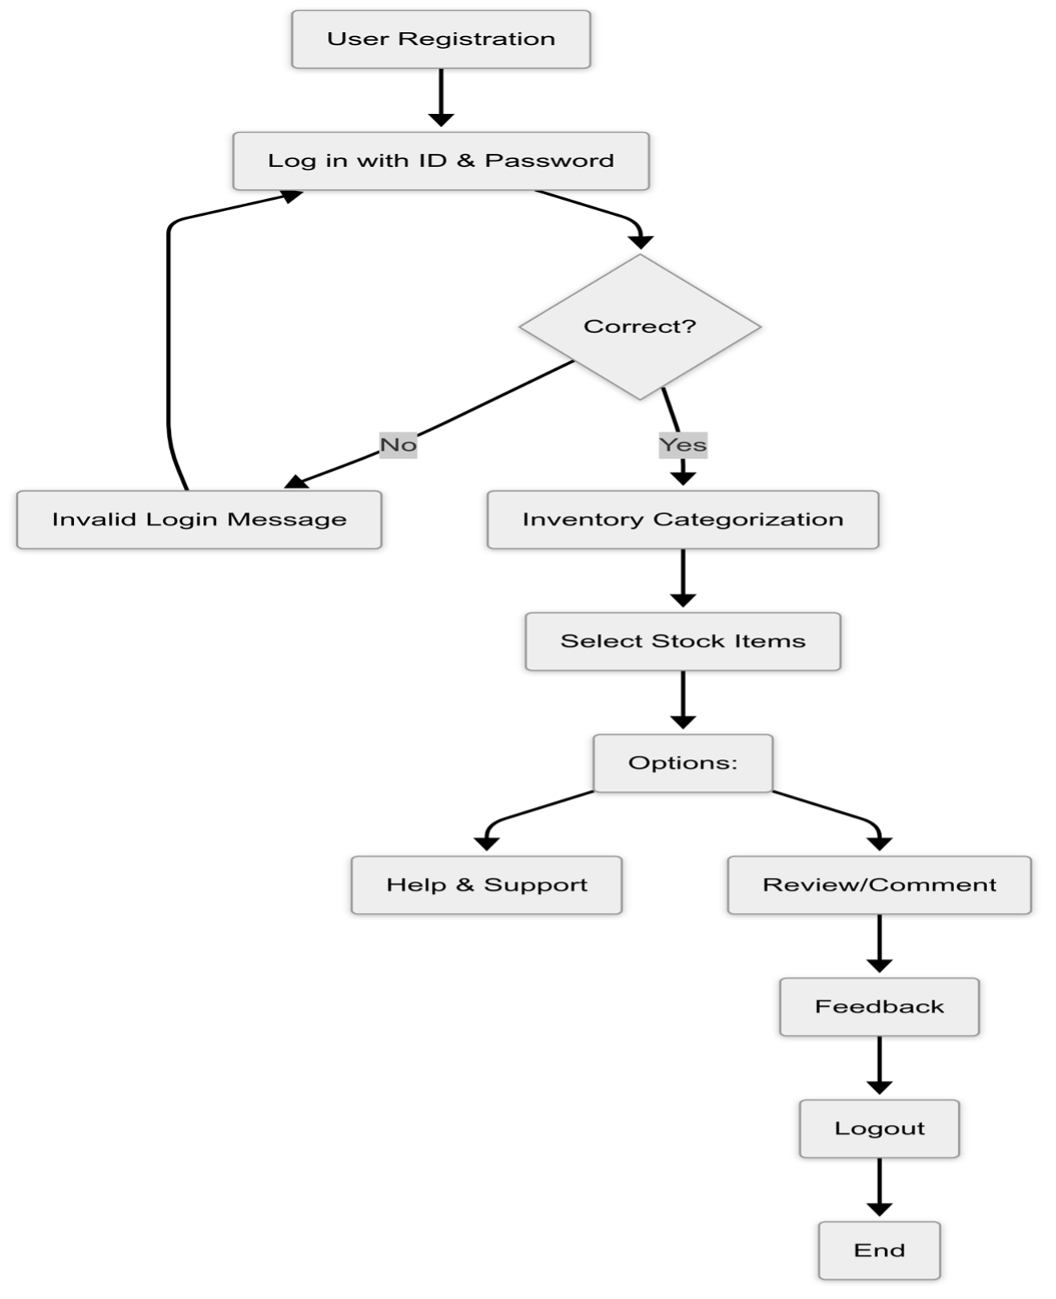
6. Theoretical Analysis
6.1 Block Diagram

Slide 9
6. Theoretical Analysis
6.2 Hardware Requirements:
Server/Cloud Hosting: A server or cloud hosting service to manage the application and handle data processing
User Devices: PCs, tablets, or smartphones for users to access the system.
6.3 Software Requirements:
Front-End: HTML5, CSS3, JavaScript (React, Angular, or Vue.js) for designing the user interface.
Back-End: Python (Flask or Django) or Node.js for handling requests and managing data.
Database: MySQL or MongoDB for storing inventory data and historical sales data.
Additional Tools: Web hosting services (AWS, Heroku) for deployment.

Slide 10
Applications
Retail Businesses: To manage stock levels and improve order fulfillment based on accurate demand forecasts.
E-commerce Platforms: To optimize inventory management and enhance customer experience through data-driven insights.
Manufacturing: To streamline production schedules and raw material procurement based on predicted demand.
Supply Chain Management: To improve overall efficiency by aligning inventory levels with anticipated sales.
Wholesale Distribution: Optimize inventory levels for wholesalers who supply products to retailers.
Electronics and Technology: Optimize inventory for consumer electronics, ensuring that popular products are always in stock.
Healthcare Supply Chain: Manage inventory for medical supplies and equipment in healthcare facilities.

Slide 11
GitHub Link
https://github.com/Atharv9406/SMART-INVENTORY-MANAGEMENT

Slide 12
REFERENCES
https://www.researchgate.net/publication/383560175_AI-driven_demand_forecasting_Enhancing_inventory_management_and_customer_satisfaction
https://disk.com/resources/inventory-forecasting-methods-to-reduce-stockouts-overstock/#:~:text=Seasonality%20Analysis,-Retailers%20often%20face&text=This%20method%20relies%20on%20historical,by%20managing%20their%20inventory%20carefully
https://www.pecan.ai/blog/predictive-inventory-management/
https://thousense.ai/blog/accurate-demand-forecasting-for-effective-inventory-management/
https://codup.co/blog/how-to-avoid-overstocking-and-stockouts-in-retail-best-practices-for-inventory-planning/
https://www.netstock.com/blog/demand-forecasting-for-supply-chains-how-to-predict-plan/
https://ijrpr.com/uploads/V5ISSUE10/IJRPR34021.pdf

Slide 13
Thank You
Queries ?

